Slide 1
Summer Internship Program
Week 1
Languages chosen:
Java C++

Slide 2
Why I chose Java and C++?
Java:
It is being taught in our current semester
It has a wide scope
I feel the need to practice and explore it more
C++ :
I’ve studied C++ in the school and I really like it
It is asked in many placement exams
I need more practice in writing codes and solving problems in it

Slide 3
Tasks done in C++
I solved 8 problems from LeetCode’s algorithm dashboard namely:
Two Sum
Reverse Integer
Palindrome Number
Roman to Integer
Longest common Prefix
Valid Paranthesis
Merge two sorted lists
Search Insert Position

Slide 4
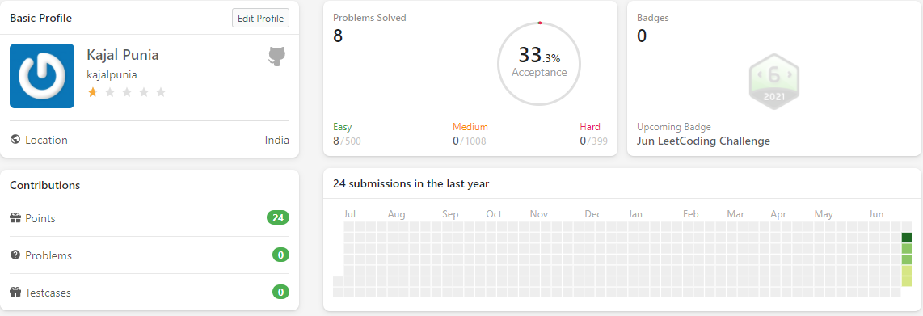
Leetcode profile

Slide 5
Tasks done in Java
I solved 4 practice problems of java from GeeksforGeeks:
Special count
Count odd even
Matrix interchange
Predict the column

Slide 6
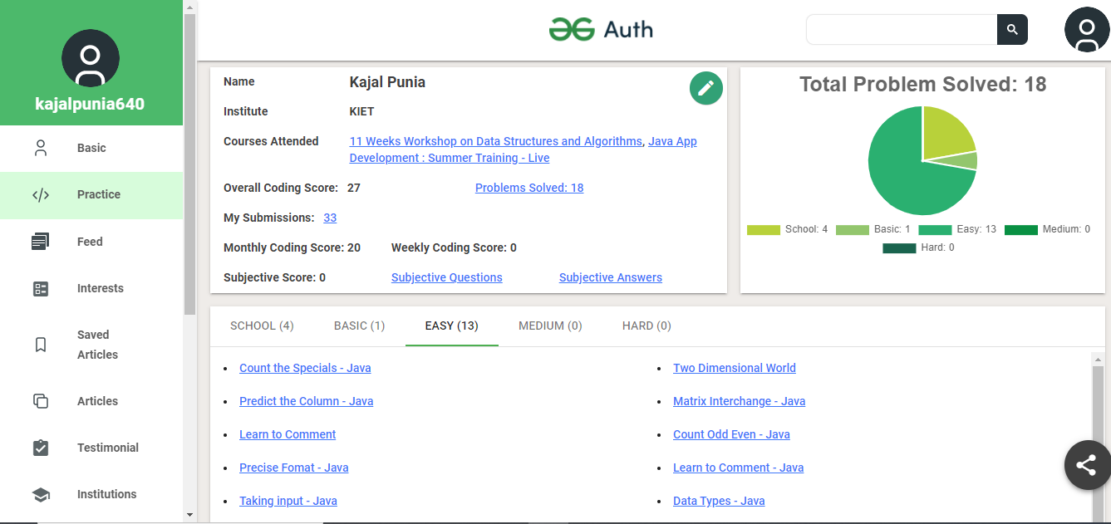
GeeksforGeeks Profile

Slide 7
Github Tasks:
Java:
I created new repository named GeeksforGeeks and uploaded 4 codes in it.
C++:
I created new repository named LeetCode and uploaded 8 codes.

Slide 8
summary
LeetCode submissions in C++ = 8; https://leetcode.com/kajalpunia/
GeeksforGeeks submissions in java= 4; https://auth.geeksforgeeks.org/user/kajalpunia640/practice/
Contributions on GitHub = 12; https://github.com/kajalpunia
Linkedin: https://www.linkedin.com/in/kajal-punia/

